Slide 1
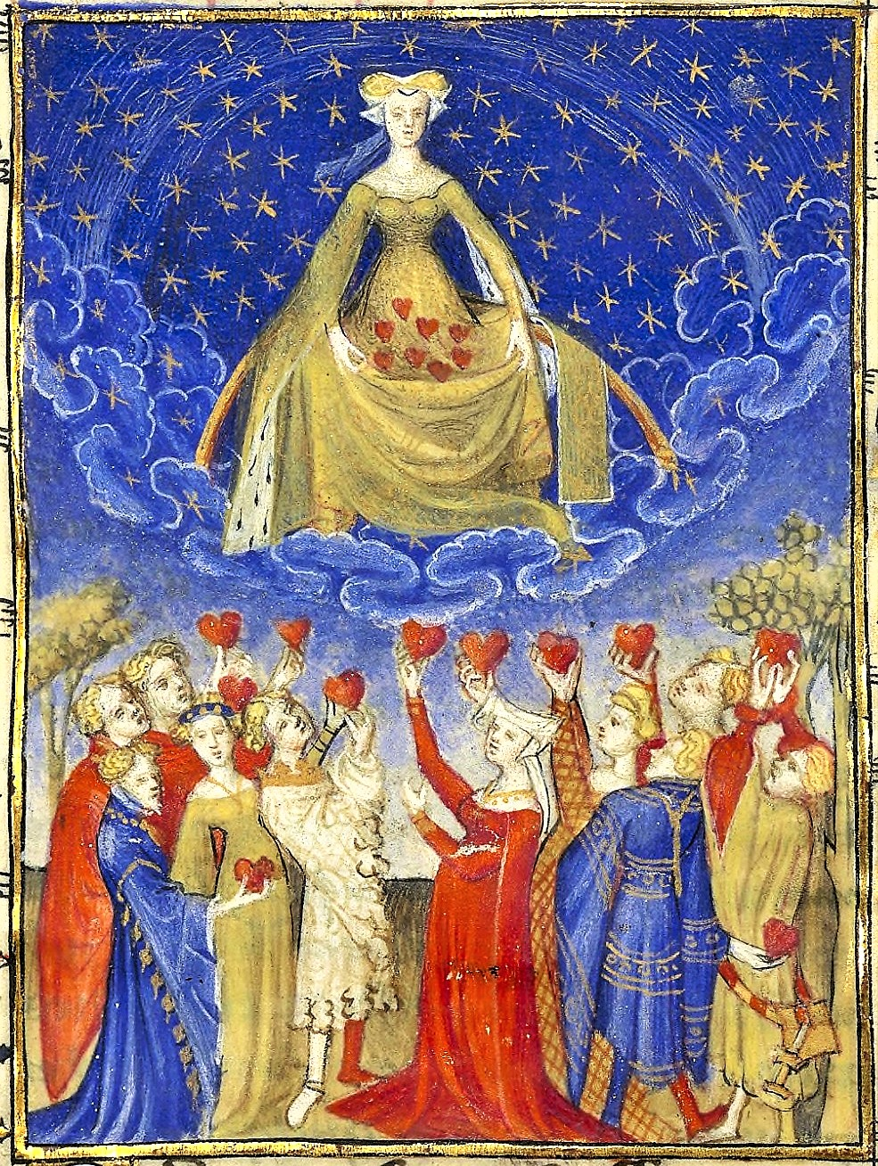
Conclusions, Titles, & Works Cited
Christine de Pizan, L’Epistre Othea
15th c., Bib. nat. France, ms fr. 606, f. 6r

Slide 2
Conclusions Looking inward
Summary
Restatement of the thesis (not a mere repetition) that is more thoughtful and insightful
May need to revise initial placeholder thesis depending on where you essay has ended up
By end of essay, you have the weight of all the evidence behind you, and can be more definitive
Echoing/Framing
“Close the circle” by returning to an idea, image, word, or phrase suggested in the beginning
Provide a solution to the problem or answer the question you asked

Slide 3
Conclusions Looking Outward
Context
Contextualize argument by suggesting way in which material applies to a larger concern
So what?
What are the implications of your argument? Broader significance?
BUT: Avoid making new, unsubstantiated claims
Now what?
Consider work that remains to be done
Are there limitations to your approach? Ideas that fall outside of the scope of your essay? Suggestions for future research?

Slide 4
Conclusions How not to end an essay
The Sopranos Ending (leaves off abruptly)
The Groundhog Day (or, Déjà Vu) Ending (keeps repeating itself)
Don’t introduce new information or ideas
Avoid phrases like: “in conclusion…,” “to sum up…,” “in summary…”
Resist the urge to apologize

Slide 5
Titles Making a good first impression
What does a good title look like?
Specific and inviting
Announces paper topic
Gestures toward the complexity of the argument
Raises the reader’s curiosity

Slide 6
Titles Making a good first impression
What to avoid?
Uninformative
“A New Reading of Gerald of Wales’ Topography of Ireland”
Overdone jokes/puns, “edgy”

Slide 7
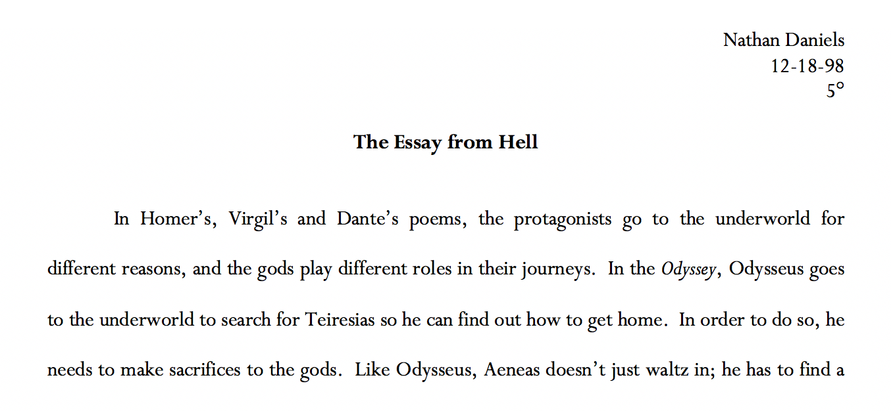
Titles Making a good first impression (!)

Slide 8
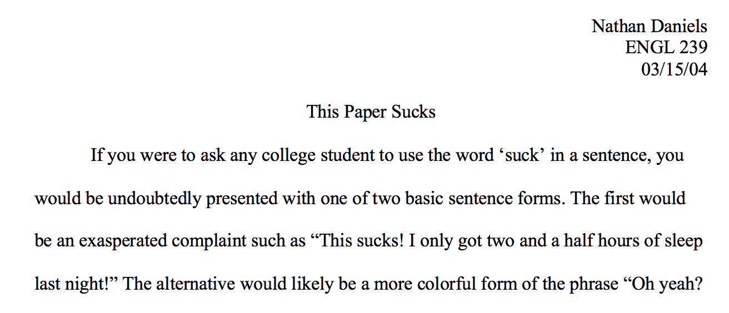
Titles Making a good first impression (!)

Slide 9
Titles Making a good first impression
What to avoid?
Uninformative
“A New Reading of Gerald of Wales’ Topography of Ireland”
Overdone jokes/puns, “edgy”
Clichés
“To Wait or Not to Wait: Two Approaches to Exile in Benjamin of Tudela”
Grandiose / Incomprehensible
“Towards a New Hermeneutics of Medieval Jewish Eschatology: Re-Interpreting Messianism and David Alroy in Benjamin of Tudela’s Itinerary”
Forgetting to change your placeholder title…
“Title, When I think of It, Goes Here”

Slide 10
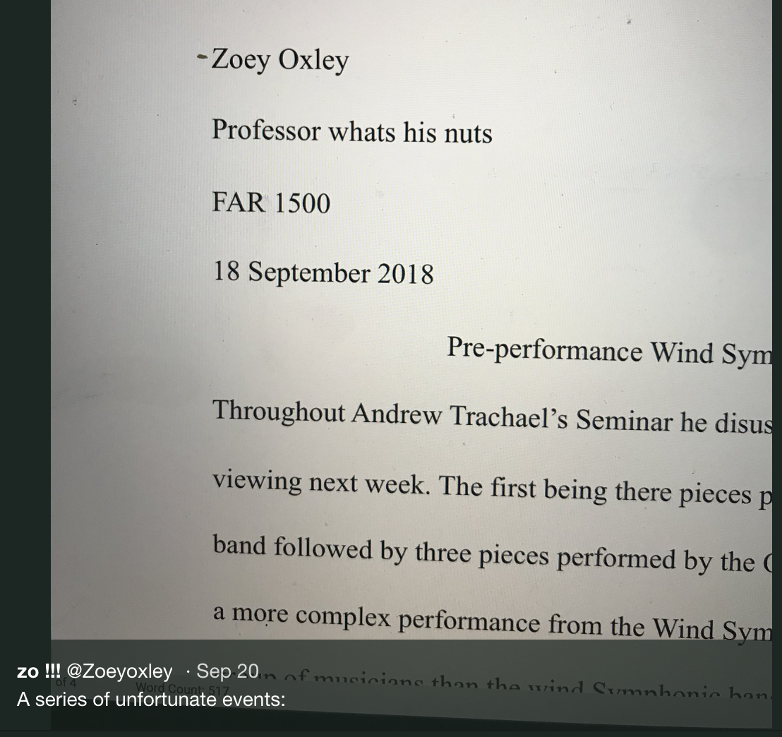
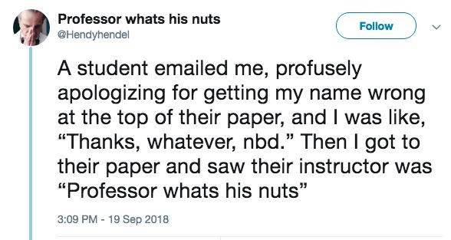
Titles Making a good first impression

Slide 11
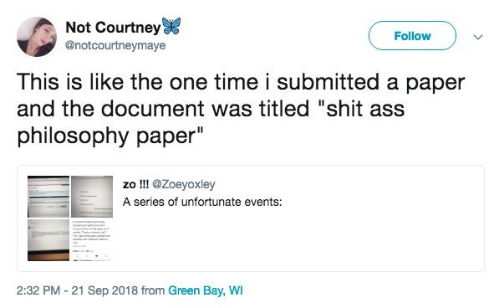
Titles Making a good first impression

Slide 12
Titles Making a good first impression
What to avoid?
Uninformative
“A New Reading of Gerald of Wales’ Topography of Ireland”
Overdone jokes/puns, “edgy”
Clichés
“To Wait or Not to Wait: Two Approaches to Exile in Benjamin of Tudela”
Grandiose / Incomprehensible
“Towards a New Hermeneutics of Medieval Jewish Eschatology: Re-Reading David Alroy in Benjamin of Tudela’s Itinerary”
Forgetting to change your placeholder title…
“Title, When I think of It, Goes Here”
Or, the title from the previous assignment

Slide 13
Titles When all else fails…
A few tried and true formulas:
_____ and _____ in ____________ (Specific/Complexity)
“Authority and Order in Benjamin of Tudela’s Itinerary”
[X (, Y, and Z)]: [Description] (Specific/Complexity/Curiosity?)
“Minstrels, Guild Organization, and Medieval Urban Life: A Case Study of the Confraternity of Jongleurs in Paris, 1292-1350”
[Quote from text]: [Description] (Inviting/Curiosity/Specific/Complexity)
“The Imposter Sea: The Making of the Medieval Mediterranean”
“Servants of All, Servants of None: Jews and the State in the Kingdom of Acre, 1188-1291

Slide 14
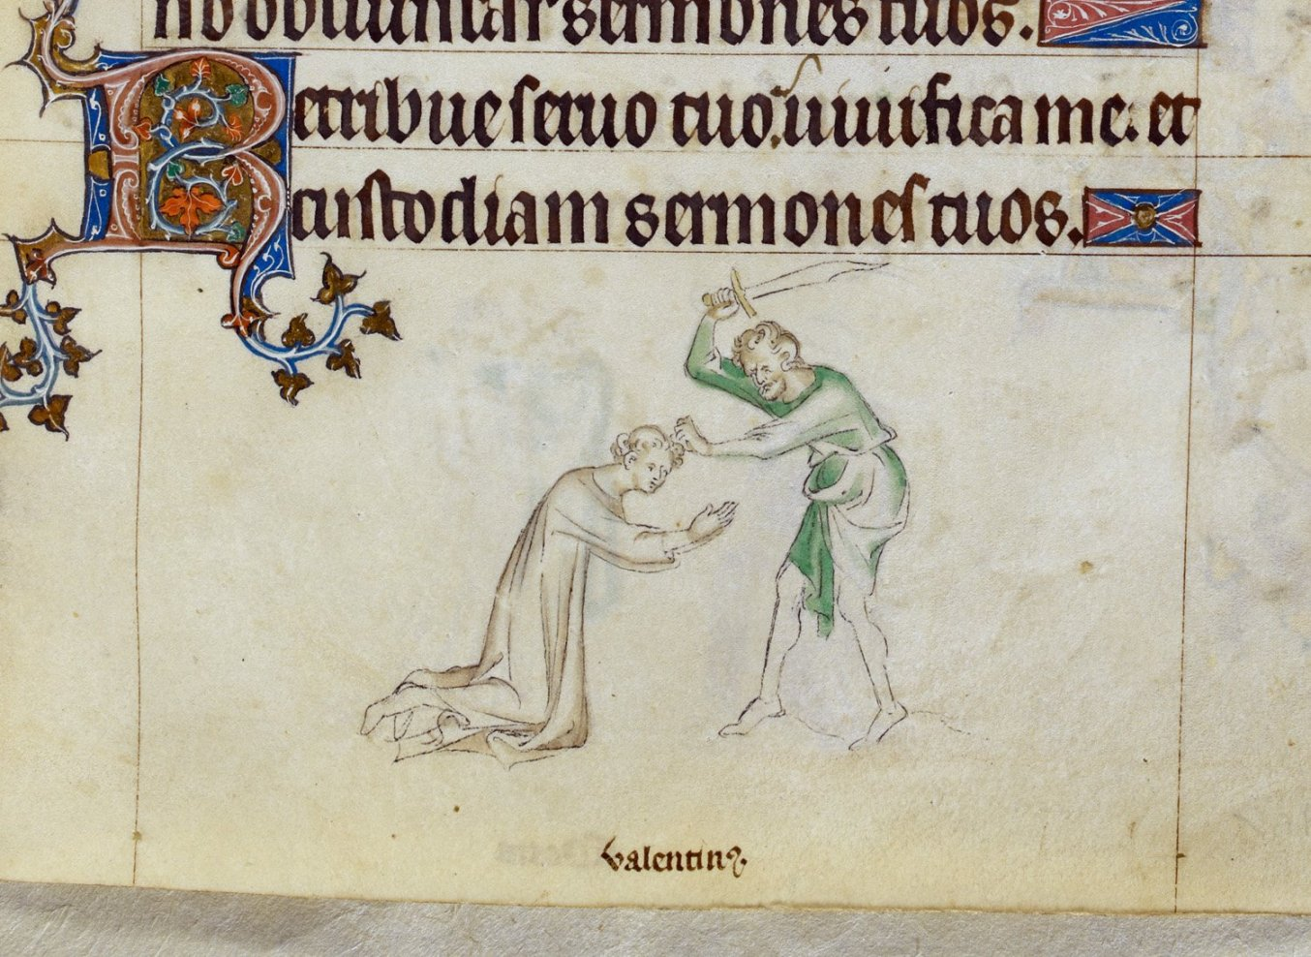
Happy Valentine’s Day
St. Valentine of Rome (d. 14 Feb 269)
British Library, Royal MS 2 B VII, f. 243

Slide 15
Works Cited MLA Format
Works Cited Section
Print “Works Cited” at end of paper
Alphabetize listed works by last name
If single entry exceeds one line, indent the second line
Basic MLA Book Format(s)
Last, First MI. Title in Italics. Publisher, Date.
Last, First. Title in Italics. Edited by First Last, Publisher, Date.
Last, First MI, editor. Title in Italics. Translated by First Last, Publisher, Date.
Last, First. Title in Italics. Translated by First Last, edited by First Last, Publisher, Date.

Slide 16
Works Cited MLA Format
Basic MLA Book Format(s)
Last, First MI. Title in Italics. Publisher, Date.
Last, First. Title in Italics. Edited by First Last, Publisher, Date.
Last, First MI, editor. Title in Italics. Translated by First Last, Publisher, Date.
Last, First. Title in Italics. Translated by First Last, edited by First Last, Publisher, Date.
Benjamin of Tudela
Author: Benjamin [of Tudela]
Editor: Michael A. Signer
Translator: Marcus N. Adler
Publisher: Pangloss Press
Date: 1983

